Slide 1
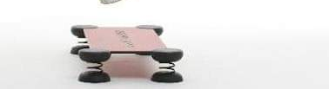
STEP

Slide 2
Families of movements
Regarding the set of steps or movements that are used in group fitness for teaching convenience, it is used to distinguish them into two families of steps:
STEPS OF THE FIRST FAMILY: they do not change the starting foot
STEPS OF THE SECOND FAMILY: they change the starting foot

Slide 3
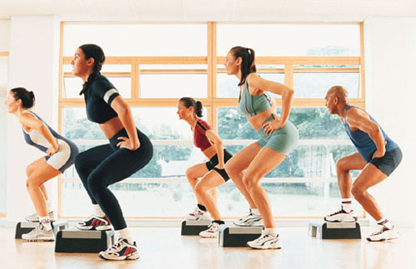
Step :BASIC STEP OF THE FIRST FAMILY
Basic step
V step
Reverse
Over the top
Straddle
Lunge
Box step
Mambo
Pivot turn
Baby mambo o rock

Slide 4
Step :BASIC STEP OF THE SECOND FAMILY
Knee up
Tap up
Leg curl
Kick front
Kick back
Repeaters
L step
Twist
Cha cha step
Mambo chacha
straddle

